Slide 1
Pager Rotation Duties
Jeremy Ginter, 7/7/2024

Slide 2
What is Pager Rotation?
Pager rotation duties helps to mitigate unexpected problems and outages when the occur at inconvenient times (Gene et al., 2016).
People on pager rotation are expected to be on call during certain times in case the application has an error that needs an immediate solution.
It works by spreading the responsibility of fixing these issues to everyone in the value stream.

Slide 3
Why is Pager Rotation Effective
One reason that makes pager rotation more effective is that it prevents the operations team from being isolated(book). More people are required to assist in solving incidents, spreading the work and making sure these can be mitigated quickly ().
This also incentivizes the development team and development management to ensure features are working correctly and wont cause issues before they are marked as done.
This also ensure important issues get solved quickly, since developers that are called in to fix an issue at an inconvenient time will be incentivized to solve it quickly (Gene et al., 2016).

Slide 4
Creating a Pager Rotation Schedule
The goal of a good pager rotation schedule is to have 24/7 coverage in case a problem presents itself (Incident.io, 2024).
When creating a good pager rotation schedule, it is important to consider Alert-fatigue. Alert-fatigue happens when an individual is consistently having to respond to calls to solve incidents.
The best way to prevent Alert-fatigue is to design a schedule that shares the workload between everyone on call equally and works well for the work conditions of everyone on the team (Incident.io, 2024).

Slide 5
Rotation Types
An article by Incident.io outlines three useful rotation types; Bi-weekly, Week and Weekends, and Follow-the-Sun (Incident.io, 2024).
Bi-weekly rotation works by rotating what team members are on call every other week, meaning each individual would be on call two weeks at a time.
Week and weekend rotation by having one group be on call during the weekdays, and another group be on call during the weekends.
Follow-the-Sun rotation is ideal for development teams working in different locations. If team members are working on different sides of the world, you can ensure there is always someone available to solve issues during their normal work hours (Incident.io, 2024).

Slide 6
Balancing Pager Rotation
Incident.io suggests to consider people’s availability, skills, and seniority when creating a rotation schedule. This helps to create a fair distribution and prevents people who aren’t experienced enough to solve issues in situations where they cannot solve the problem (Incident.io, 2024).
While the amount of people that should be in rotation at one time is largely dependent on the circumstances of the application, incident.io suggests groups should be 6-8 people to reduce burnout and prevent people from not having enough understanding of the program (Incident.io, 2024).

Slide 7
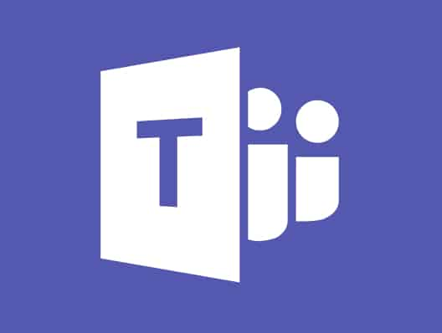
Collaboration during Pager Rotation
An article by AlertOps.com explains that one of the most common problems with having different teams on-call is the lack of communication between these teams (AlertOps.com, 2023).
Using software such as slack or Microsoft Teams or Slack can help to increase communication and allow important information to be shared between teams.

Slide 8
Alerts
Having an alert system in place to detect when something goes wrong is extremely important in order for pager rotation to be effective. Without this, people on-call would not be informed when they are needed to solve an issue (AlertOps.com, 2023).
To solve this issue, a rule-based system should be implemented in order to detect when something isn’t working as intended and inform those on call that it needs to be fixed.
Having an effective system like this in place can considerable improve how fast these issues can be solved, allowing the application to continue to work as intended (AlertOps.com, 2023).

Slide 9
References
AlertOps.com. (2023, January 27). Best practices for managing on-call rotation (in 2023). AlertOps. https://alertops.com/on-call-rotation/
Gene, K., Humble, J., Debois, P., Willis, J., & Forsgren, N. (2016). DevOps Handbook. IT Revolution Press.
Incident.io. (2024, February 26). Best practices for creating a reliable on-call rotation. incident.io - Incident management that brings calm to chaos. https://incident.io/hubs/on-call/on-call-rotation-best-practices

